Slide 1
Dyslexia-Specific Assistive Technology (AT)
By: Stephen Berdos

Slide 2

Which Clients are Appropriate for this Service?
Diagnosed with Dyslexia (or a reading-related learning disability).
Meets financial need for paid services.
Enrolled in college (or plans to enroll in college) or is actively looking for work.

Slide 3

Step One
Complete a referral to receive vocational rehabilitation services through The Massachusetts Rehabilitation Commission.
Meet with me to complete the initial interview, eligibility and establish your Individual Plan for Employment (IPE).

Slide 4

Step Two
During our meeting I’ll demonstrate the basics of (1) Read & Write Gold, (2) OpenDyslexic Font, (3) Reading Guide, (4) Document Holder, (5) Perkins Library.
MRC may not be able to purchase these items for you. Our resources are dependent on our budget and you also need to meet financial need for paid services. However, these items are all relatively inexpensive. The benefit of seeing them in-person is knowing what AT works for you, and what does not.

Slide 5

Step Three
If you feel you would benefit from these assistive technology options and you meet financial need for paid services, an assistive technology evaluation with Easter Seals will be scheduled.
If you would like to apply for membership to the Perkins Library, I can assist with that.

Slide 6

Read & Write Gold
Improves confidence and understanding levels for struggling readers.
Helps students and employees with Dyslexia and other literacy challenges.
Supports independent learning and understanding.

Slide 7
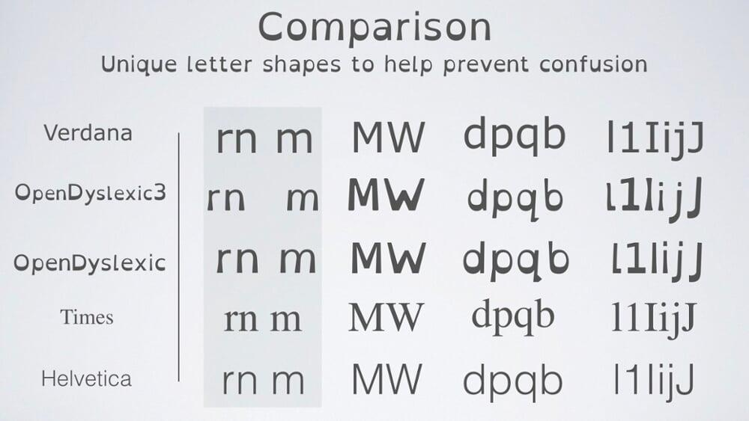
OpenDyslexic Font
Free font designed to increase readability for those with Dyslexia.
It was intended to address: contrast/blindness, letter confusion or rotation, and crowding.
Letters have heavy weighted bottoms to indicate direction. The unique shapes of each letter can help prevent confusion through flipping and swapping.

Slide 8

Reading Guide
Practical assistive reading tool designed to help readers focus and remember what they read.
Many people with Dyslexia struggle with orientation; losing your place when reading. These reading guides help address that issue.
There are scenarios where audio books will not be an option and a person with Dyslexia will need to read text on a page.

Slide 9
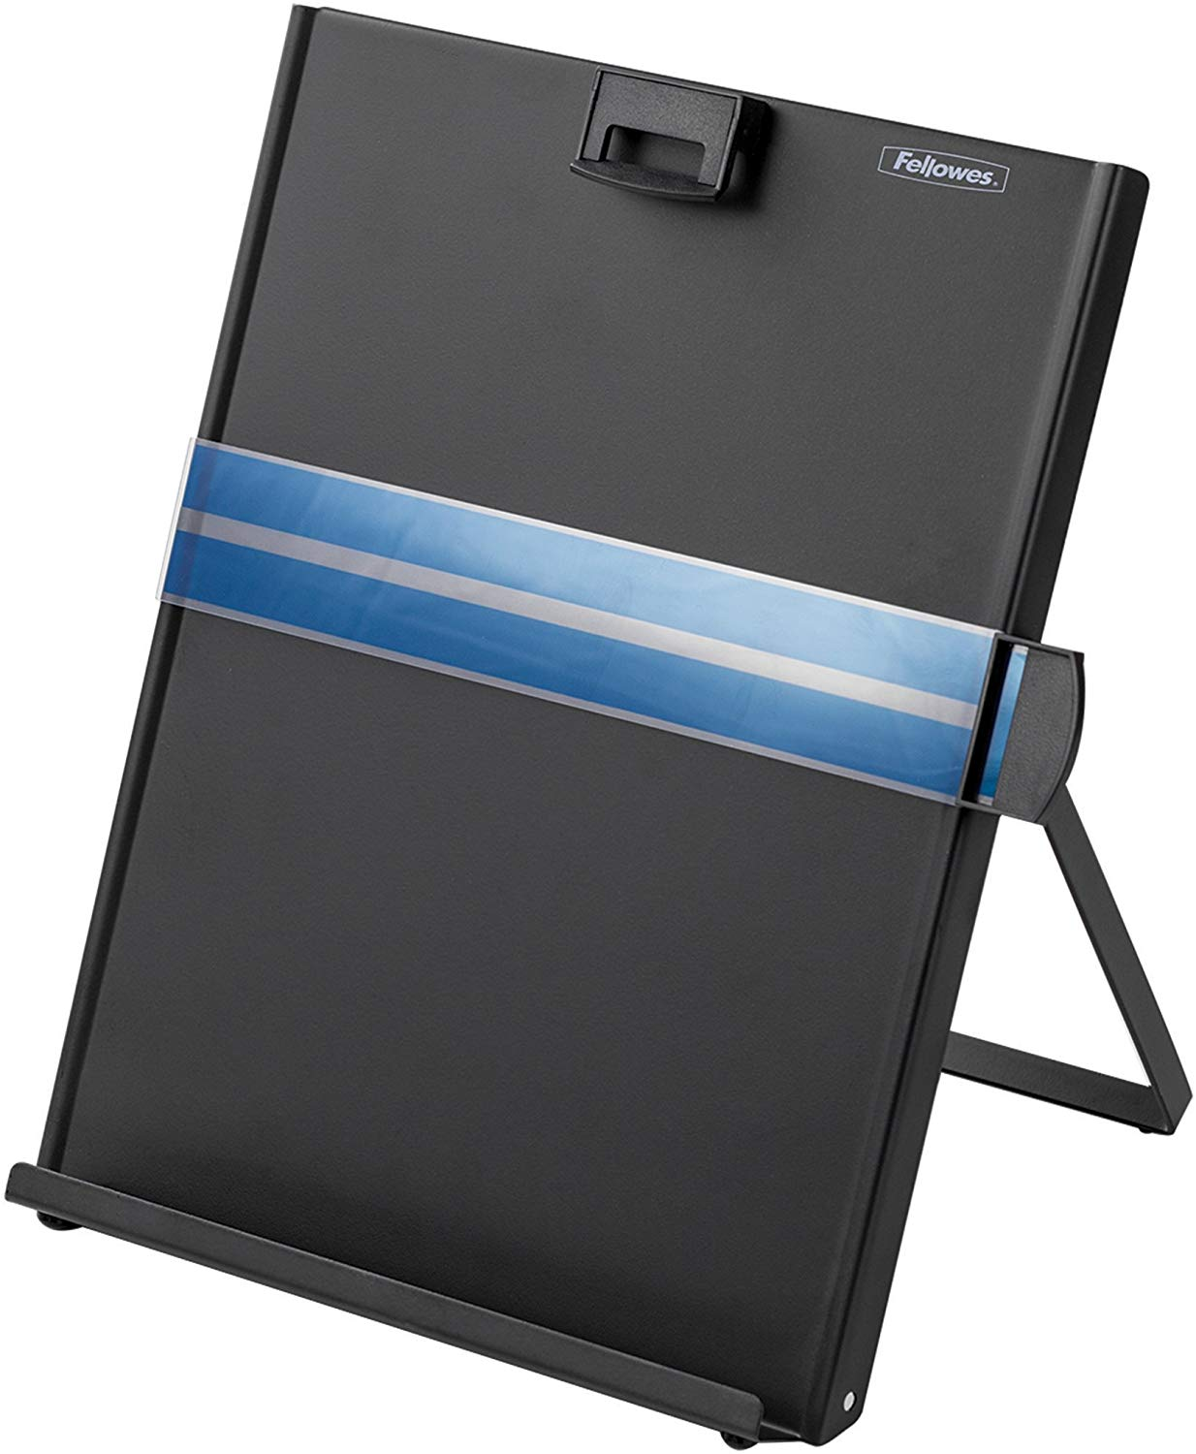
Document Holder
Helps to keep readers oriented.
Assists with accurately tracking sentences to improve reading speed and reading comprehension.
Is an organizational tool that will keep readers focused.

Slide 10
Perkins Talking Book Library
The Perkins Talking Book Library primarily serves individuals who are blind or visually impaired. However, students and adults with Dyslexia are encouraged to apply for membership.
As a member of the Perkins Talking Book Library you can take advantage of the following services:
  Access to the database of over 75,000 audio books,
  Free/reduced-fare museum/aquarium passes,
  Access to foreign language audio books,
  https://www.perkins.org/library/services

Slide 11

Thank You!

